Slide 1

Personality
Chapter 12

Slide 2
Chapter 12 Learning Objective Menu
LO 12.1 Personality
LO 12.2 Freud’s view of the divisions of the conscious mind
LO 12.3 Freud’s three parts of the personality
LO 12.4 Freud’s stages of personality development
LO 12.5 Jung, Adler, Horney, and Erikson’s modifications
LO 12.6 Modern psychoanaltyic theory
LO 12.7 How behaviorists explain personality
LO 12.8 How humanists explain personality
LO 12.9 Roger’s view of self
LO 12.10 Trait perspective
LO 12.11 How trait theorists view personality
LO 12.12 Biology and heredity’s role in personality
LO 12.13 Hofstede’s dimensions of cultural personality
LO 12.14 Using interviews to measure personality
LO 12.15 Using projective tests to measure personality
LO 12.16 Using behavioral assessments to measure personality
LO 12.17 Using personality inventories to measure personality
LO 12.18 Personality tests on the Internet

Slide 3
Personality
LO 12.1 Personality
Personality - the unique and relatively stable ways in which people think, feel, and behave.
Character - value judgments of a person’s moral and ethical behavior.
Temperament - the enduring characteristics with which each person is born.
Menu

Slide 4
Four Perspectives in Study of Personality
LO 12.1 Personality
Psychoanalytic
Behavioristic (including social cognitive theory)
Humanistic
Trait perspectives
Menu

Slide 5
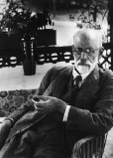
Sigmund Freud
LO 12.2 Freud’s view of the divisions of the conscious mind
Founder of the psychoanalytic movement in psychology.
Europe during the Victorian age.
  Men were understood to be unable to control their “animal” desires at times, and a good Victorian husband would father several children with his wife and then turn to a mistress for sexual comfort, leaving his virtuous wife untouched.
  Women, especially those of the upper classes, were not supposed to have sexual urges.
  Backdrop for this theory.
Menu

Slide 6
Divisions of Consciousness
LO 12.2 Freud’s view of the divisions of the conscious mind
Preconscious mind - level of the mind in which information is available but not currently conscious.
Conscious mind - level of the mind that is aware of immediate surroundings and perceptions.
Unconscious mind - level of the mind in which thoughts, feelings, memories, and other information are kept that are not easily or voluntarily brought into consciousness.
  Can be revealed in dreams and Freudian slips of the tongue.
Menu

Slide 7
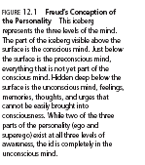
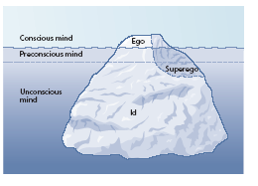
LO 12.2 Freud’s view of the divisions of the conscious mind
Menu

Slide 8
Freud’s Theory: Parts of Personality
LO 12.3 Freud’s three parts of the personality
Id - part of the personality present at birth and completely unconscious.
  Libido - the instinctual energy that may come into conflict with the demands of a society’s standards for behavior.
  Pleasure principle - principle by which the id functions; the immediate satisfaction of needs without regard for the consequences.
Ego - part of the personality that develops out of a need to deal with reality, mostly conscious, rational, and logical.
  Reality principle - principle by which the ego functions; the satisfaction of the demands of the id only when negative consequences will not result.
Superego - part of the personality that acts as a moral center.
  Ego ideal - part of the superego that contains the standards for moral behavior.
  Conscience - part of the superego that produces pride or guilt, depending on how well behavior matches or does not match the ego ideal.
Menu

Slide 9
Freud’s Theory: Stages of Personality Development
LO 12.4 Freud’s stages of personality development
Fixation - disorder in which the person does not fully resolve the conflict in a particular psychosexual stage, resulting in personality traits and behavior associated with that earlier stage.
Psychosexual stages - five stages of personality development proposed by Freud and tied to the sexual development of the child.
Menu

Slide 10
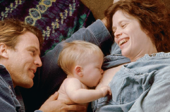
Freud’s Theory: Stages of Personality Development
LO 12.4 Freud’s stages of personality development
Oral stage - first stage occurring in the first year of life in which the mouth is the erogenous zone and weaning is the primary conflict. Id dominated.
Menu

Slide 11

Freud’s Theory: Stages of Personality Development
LO 12.4 Freud’s stages of personality development
Anal stage - second stage occurring from about 1 to 3 years of age, in which the anus is the erogenous zone and toilet training is the source of conflict. Ego develops.
  Anal expulsive personality - a person fixated in the anal stage who is messy, destructive, and hostile.
  Anal retentive personality - a person fixated in the anal stage who is neat, fussy, stingy, and stubborn.
Menu

Slide 12
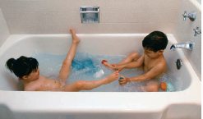
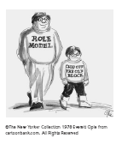
Freud’s Theory: Stages of Personality Development
LO 12.4 Freud’s stages of personality development
Phallic stage - third stage occurring from about 3 to 6 years of age, in which the child discovers sexual feelings. Superego develops.
  Oedipus complex- situation occurring in the phallic stage in which a child develops a sexual attraction to the opposite-sex parent and jealousy of the same-sex parent.
  Identification - defense mechanism in which a person tries to become like someone else to deal with anxiety.
Menu

Slide 13
Freud’s Theory: Stages of Personality Development
LO 12.4 Freud’s stages of personality development
Latency - fourth stage occurring during the school years, in which the sexual feelings of the child are repressed while the child develops in other ways.
Genital – sexual feelings reawaken with appropriate targets.
Menu

Slide 14
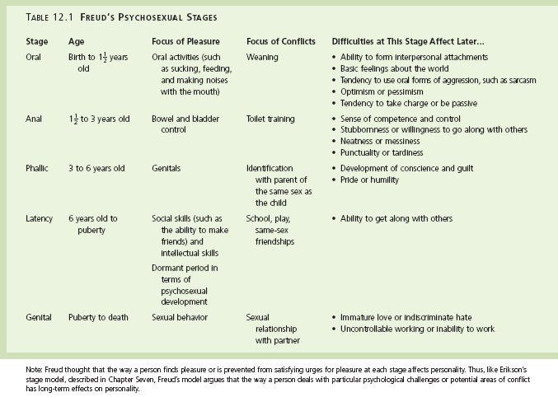
LO 12.4 Freud’s stages of personality development
Menu

Slide 15
Freud’s Psychoanalysis
LO 12.4 Freud’s stages of personality development
Psychoanalysis - Freud’s term for both the theory of personality and the therapy based on it.
Menu

Slide 16
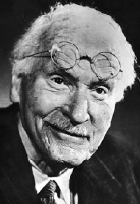
Neo-Freudians
LO 12.5 Jung, Adler, Horney, and Erikson’s modifications to Freudian theory
Neo-Freudians - followers of Freud who developed their own competing theories of psychoanalysis.
  Jung developed a theory of a collective unconscious.
    Personal unconscious - Jung’s name for the unconscious mind as described by Freud.
    Collective unconscious – Jung’s name for the memories shared by all members of the human species.
    Archetypes - Jung’s collective, universal human memories.
Menu

Slide 17
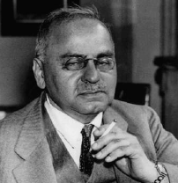
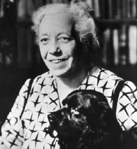
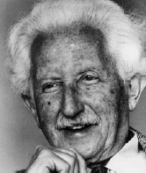
Neo-Freudians
LO 12.5 Jung, Adler, Horney, and Erikson’s modifications to Freudian theory
Adler proposed feelings of inferiority as the driving force behind personality and developed birth order theory.
Horney developed a theory based on basic anxiety and rejected the concept of penis envy.
  Basic anxiety - anxiety created when a child is born into the bigger and more powerful world of older children and adults.
  Neurotic personalities – maladaptive ways of dealing with relationships in Horney’s theory.
Erikson developed a theory based on social rather than sexual relationships, covering the entire life span.
Menu

Slide 18
Modern Psychoanalytic Theory
LO 12.6 Modern psychoanalytic theory
Current research has found support for:
  Defense mechanisms
  Concept of an unconscious mind that can influence conscious behavior
Other concepts cannot be scientifically researched.
Menu

Slide 19
Behaviorism and Personality
LO 12.7 How behaviorists explain personality
Behaviorists define personality as a set of learned responses or habits.
  Habits - in behaviorism, sets of well-learned responses that have become automatic.
Social cognitive learning theorists – theorists who emphasize the importance of both the influences of other people’s behavior and of a person’s own expectancies on learning.
Social cognitive view – learning theory that includes cognitive processes such as anticipating, judging, memory, and imitation of models.
Menu

Slide 20
Behaviorism and Personality
LO 12.7 How behaviorists explain personality
Reciprocal determinism - Bandura’s explanation of how the factors of environment, personal characteristics, and behavior can interact to determine future behavior.
Self-efficacy – individual’s perception of how effective a behavior will be in any particular circumstance (NOT the same as self-esteem).
Menu

Slide 21
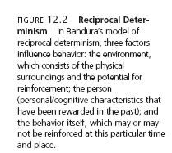
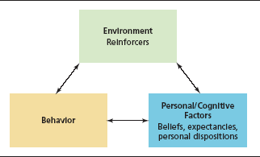
LO 12.7 How behaviorists explain personality
Menu

Slide 22
Humanistic Theories of Personality
LO 12.8 How humanists explain personality
Humanistic perspective - the “third force” in psychology that focuses on those aspects of personality that make people uniquely human, such as subjective feelings and freedom of choice.
Developed as a reaction against the negativity of psychoanalysis and the deterministic nature of behaviorism.
Menu

Slide 23
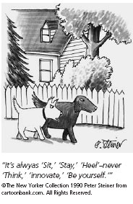
Roger’s Theory of Personality
LO 12.9 Roger’s view of self
Self-actualizing tendency – the striving to fulfill one’s innate capacities and capabilities.
Self-concept - the image of oneself that develops from interactions with important, significant people in one’s life.
Self - archetype that works with the ego to manage other archetypes and balance the personality.
Real self - one’s perception of actual characteristics, traits, and abilities.
Ideal self - one’s perception of whom one should be or would like to be.
Menu

Slide 24
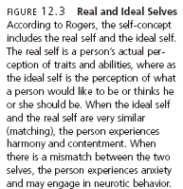
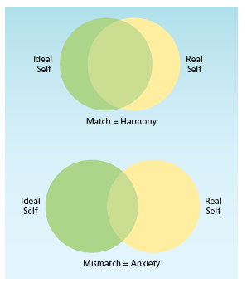
LO 12.9 Roger’s view of self
Menu

Slide 25
Roger’s Theory of Personality
LO 12.9 Roger’s view of self
Positive regard – warmth, affection, love, and respect that come from significant others in one’s life.
Unconditional positive regard - positive regard that is given without conditions or strings attached.
Conditional positive regard- positive regard that is given only when the person is doing what the providers of positive regard wish.
Fully functioning person – a person who is in touch with and trusting of the deepest, innermost urges and feelings.
Menu

Slide 26
Trait Theories of Personality
LO 12.10 Trait perspective
Trait theories - theories that endeavor to describe the characteristics that make up human personality in an effort to predict future behavior.
  Trait - a consistent, enduring way of thinking, feeling, or behaving.
Allport first developed a list of about 200 traits and believed that these traits were part of the nervous system.
Cattell reduced the number of traits to between 16 and 23 with a computer method called factor analysis.
Menu

Slide 27
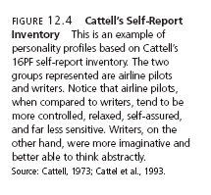
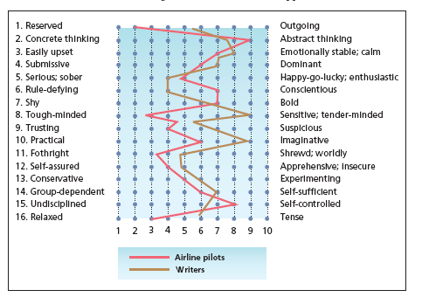
LO 12.10 Trait perspective
Menu

Slide 28
Trait Theories of Personality
LO 12.10 Trait perspective
Surface traits - aspects of personality that can easily be seen by other people in the outward actions of a person.
Source traits - the more basic traits that underlie the surface traits, forming the core of personality.
  Example: Introversion - dimension of personality in which people tend to withdraw from excessive stimulation.
Menu

Slide 29
The Big Five Theory
LO 12.10 Trait perspective
Five-factor model (Big Five) - model of personality traits that describes five basic trait dimensions.
  Openness - one of the five factors; willingness to try new things and be open to new experiences.
  Conscientiousness - the care a person gives to organization and thoughtfulness of others; dependability.
Menu

Slide 30
The Big Five Theory
LO 12.10 Trait perspective
  Extraversion - dimension of personality referring to one’s need to be with other people.
    Extraverts - people who are outgoing and sociable.
    Introverts - people who prefer solitude and dislike being the center of attention.
  Agreeableness - the emotional style of a person that may range from easygoing, friendly, and likeable to grumpy, crabby, and unpleasant.
  Neuroticism - degree of emotional instability or stability.
Menu

Slide 31
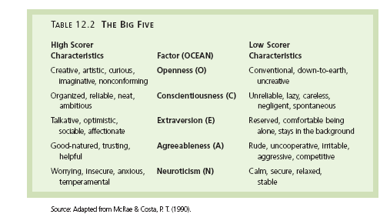
LO 12.10 Trait perspective
Menu

Slide 32
Trait Theories Today
LO 12.11 How trait theorists view personality
Cross-cultural research has found support for the five-factor model of personality traits in a number of different cultures.
  Future research will explore the degree to which child-rearing practices and heredity may influence the five personality factors.
Trait–situation interaction - the assumption that the particular circumstances of any given situation will influence the way in which a trait is expressed.
Menu

Slide 33
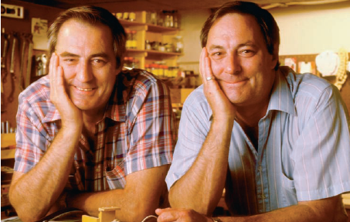
Biology and Personality
LO 12.12 Biology and heredity’s role in personality
Behavior genetics - a field of study of the relationship between heredity and personality.
  Twin and adoption studies have found support for a genetic influence on many personality traits.
James Arthur Springer and James
Edward Lewis, otherwise known as the
“Jim” twins. Although separated
shortly after birth and reunited at age
39, they exhibited many similarities in
personality and personal habits.
Menu

Slide 34
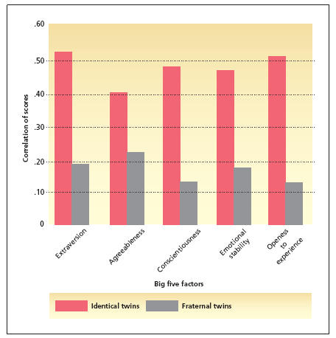
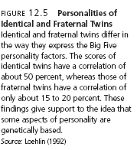
LO 12.12 Biology and heredity’s role in personality
Menu

Slide 35
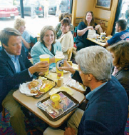
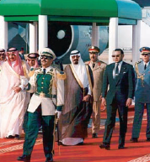
Cultural Personality
LO 12.13 Hofstede’s dimensions of cultural personality
Four basic dimensions of personality along which cultures may vary:
  individualism/collectivism
  power distance
  masculinity/femininity
  uncertainty avoidance
Menu

Slide 36
Measuring Personality: Interviews
LO 12.14 Using interviews to measure personality
Interview - method of personality assessment in which the professional asks questions of the client and allows the client to answer, either in a structured or unstructured fashion.
Halo effect – tendency of an interviewer to allow positive characteristics of a client to influence the assessments of the client’s behavior and statements.
Menu

Slide 37
Measuring Personality: Projective Tests
LO 12.15 Using projective tests to measure personality
Projection - defense mechanism involving placing, or “projecting,” one’s own unacceptable thoughts onto others, as if the thoughts actually belonged to those others and not to oneself.
Projective tests – personality assessments that present ambiguous visual stimuli to the client and ask the client to respond with whatever comes to mind.
Rorschach inkblot test - projective test that uses 10 inkblots as the ambiguous stimuli.
Thematic Apperception Test (TAT) - projective test that uses 20 pictures of people in ambiguous situations as the visual stimuli.
Subjective - concepts and impressions that are only valid within a particular person’s perception and may be influenced by biases, prejudice, and personal experiences. This is a problem with projective tests.
Menu

Slide 38
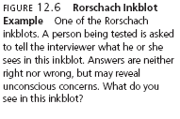
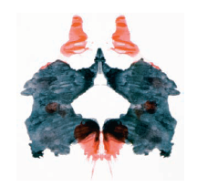
LO 12.15 Using projective tests to measure personality
Menu

Slide 39
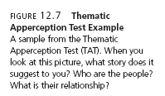
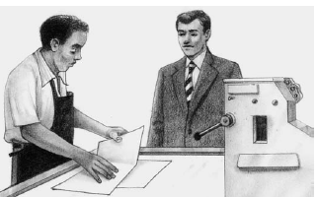
LO 12.15 Using projective tests to measure personality
Menu

Slide 40
Measuring Personality: Behavioral Measures
LO 12.16 Using behavioral assessments to measure personality
Direct observation – assessment in which the professional observes the client engaged in ordinary, day-to-day behavior in either a clinical or natural setting.
Rating scale- assessment in which a numerical value is assigned to specific behavior that is listed in the scale.
Frequency count – assessment in which the frequency of a particular behavior is counted.
Menu

Slide 41
Measuring Personality: Personality Inventory
LO 12.17 Using personality inventories to measure personality
Personality inventory - paper and pencil or computerized test that consists of statements that require a specific, standardized response from the person taking the test.
  NEO-PI - based on the five-factor model
  Myers-Briggs Type Indicator - based on Jung’s theory of personality types.
  MMPI-2 - designed to detect abnormal personality.
Menu

Slide 42
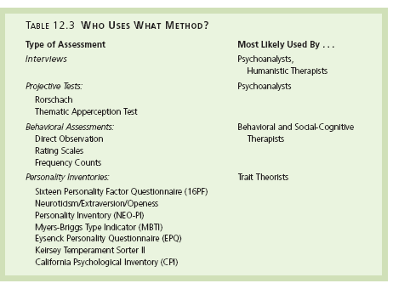
Menu

Slide 43
Personality Tests and Internet
LO 12.18 Personality tests on the Internet
There are numerous personality tests available on the Internet.
Not all equal in quality, reliability, or validity.
Lack of professional interpretation of the results of such tests.
Menu

